Slide 1

PEFT(Parameter Efficient FineTuning)
By

Slide 2
PreTraining Vs FineTuning Vs PEFT
PreTraining
Training a model from scratch on a huge, generic corpus so it learns:
Language structure
World knowledge
Reasoning patterns
Objective
Usually self-supervised
Next-token prediction
Masked language modeling
Data
Internet text
Books, code, papers
Trillions of tokens
Parameters updated
All model parameters
Cost
Very expensive
Example
GPT-3, LLaMA, Mistral base models
Training on thousands of GPUs for weeks
Mental model
“Teach the model how language works.”

Slide 3
PreTraining Vs FineTuning Vs PEFT
FineTuning
Further training a pretrained model on a task-specific dataset
Objective
Instruction following
Classification
Domain adaptation
Chat alignment (SFT, RLHF)
Data
Labeled or curated datasets
Much smaller than pretraining
Parameters updated
All parameters (same as base model)
Cost
Still expensive
Pros
Maximum flexibility
Strong task performance
Cons
High GPU memory
Risk of catastrophic forgetting
Example
Fine-tuning LLaMA on medical QA
Chat models trained via SFT + RLHF
Mental model
“Rewire the entire brain for a specific task.”

Slide 4
PreTraining Vs FineTuning Vs PEFT
PEFT(Parameter Efficient Fine Tuning)
Fine-tuning only a small subset of parameters while keeping the base model frozen.
Parameters updated
Base model frozen
Only adapter parameters (0.1%–2%)
Cost
Very cheap
Pros
Memory efficient
Faster training
Multiple adapters per base model
Cons
Slight performance trade-off vs full FT
Example
Fine-tuning LLaMA-2-7B using LoRA (r=8)
Domain adapters for finance, legal, healthcare
Mental model
“Add skill modules without changing the brain.”
Popular PEFT methods
Method | What it does
LoRA | Adds low-rank adapters to attention/MLP layers
QLoRA | LoRA + 4-bit quantization
Series | Adding adapter layers in series
Parallel | Adding adapter layers in Parallel
Adapters are a parameter-efficient way to fine-tune large models without modifying all of their original weights.

Slide 5
PreTraining Vs FineTuning Vs PEFT
Aspect | Pretraining | Fine-tuning | PEFT
Start point | Random init | Pretrained model | Pretrained model
Params trained | 100% | 100% | ~ 0.1 – 2%
Data size | Massive | Medium | Small
Cost | Very high | High | Low
Risk of forgetting | NA | Possible | No

Slide 6
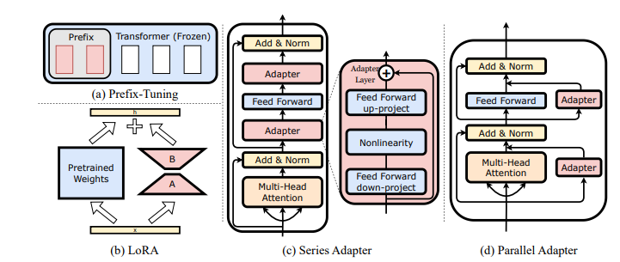
Adapters
Adapters are small trainable modules inserted into a frozen pretrained model.
Adapters can vary based on where they are inserted and how they interact with the main model.
a. Prefix Tuning / Prompt-based Adapter
Instead of adding weights in the layer, learns extra “prefix tokens” that are prepended to the input sequence.
Works well for language models because it can guide attention mechanisms.
Input Tokens → [Learned Prefix] + Input → Transformer
b. LoRA (Low-Rank Adaptation)
Special form of adapter applied to projection matrices in attention layers (Q, K, V, or output).
Replaces full weight updates with low-rank matrices.
Efficient and often achieves comparable performance to full fine-tuning.
c. Standard (Sequential) Adapter
Inserted after each transformer layer, sequentially.
Only adapter parameters are trained.
Simple and widely used.
Transformer Layer → Adapter → Next Layer
d. Parallel Adapter
Adapter runs in parallel to the layer output.
Output = Layer output + Adapter output.
Advantage: Original layer computation is preserved; adapter adds task-specific info.
Output = Layer(input) + Adapter(input)
Common types include:
Notes:
https://arxiv.org/pdf/2304.01933 -- LLM-Adapters: An Adapter Family for Parameter-Efficient Fine-Tuning of Large Language Models

Slide 7
LoRA (Low-Rank Adaptation)
What problem LoRA solves
Full fine-tuning updates billions of parameters, which causes:
High GPU memory usage
Slow training
Storage issues (one copy per task)
Risk of catastrophic forgetting
LoRA solves this by:
Freezing the base model and learning low-rank updates to weight matrices.

Slide 8
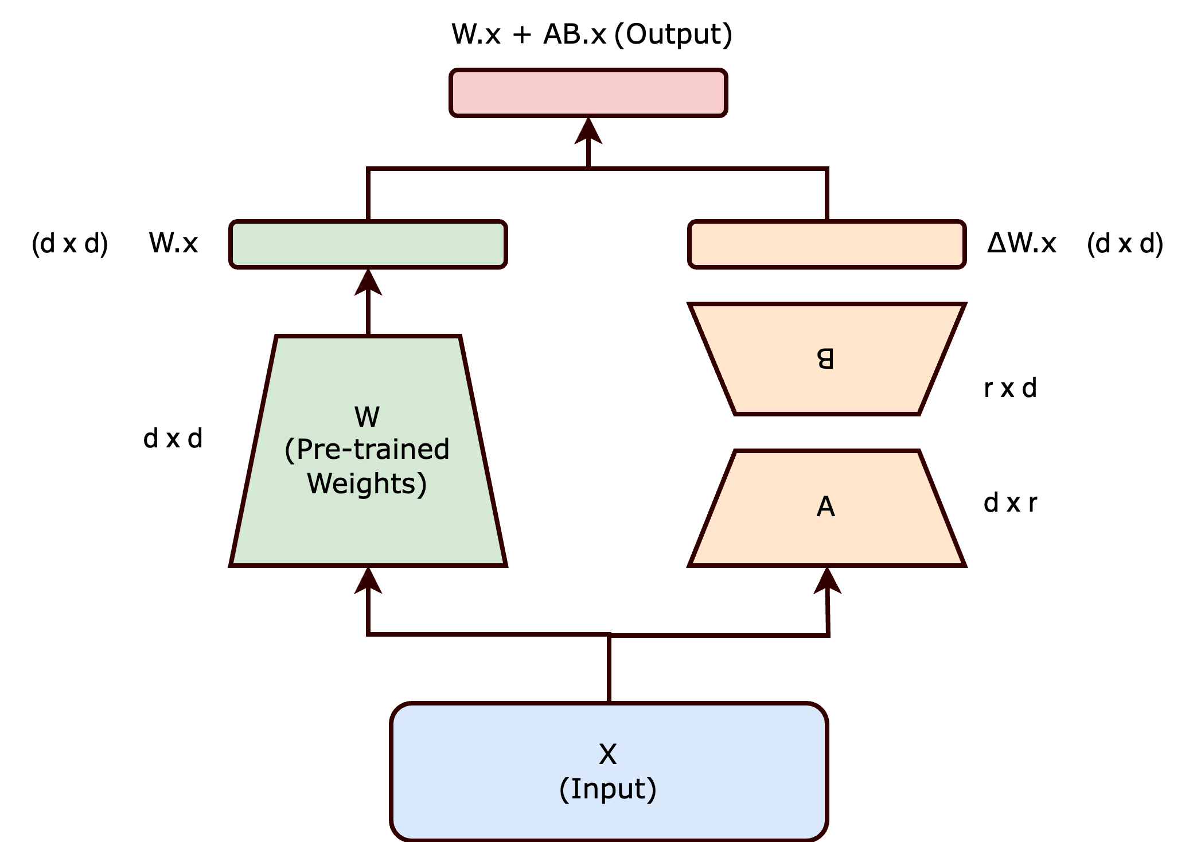
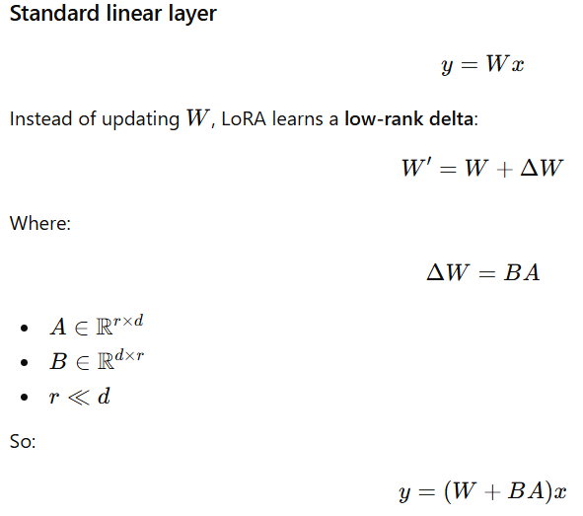

LoRA (Low-Rank Adaptation)
Alpha (scaling factor) controls the magnitude of LoRA’s contribution
Larger α → LoRA update has more influence
Smaller α → LoRA update is weaker, base model dominates
Think of alpha as a volume knob for the LoRA adapter.
r = Rank of LoRA

Slide 9
LoRA (Low-Rank Adaptation)
What is “rank” (core concept)
Rank = number of linearly independent rows or columns
Equivalently:
Rank = number of independent directions the matrix can represent.
Visual intuition (very important)
Imagine points in 3D space.
Full-rank transformation
Points spread in x, y, z
You need 3 independent directions
Low-rank transformation
All points lie on:
a plane → rank = 2
a line → rank = 1
Example: Shadow for a real object

Slide 10
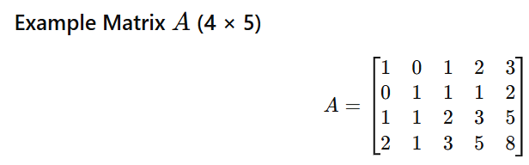
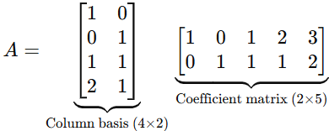
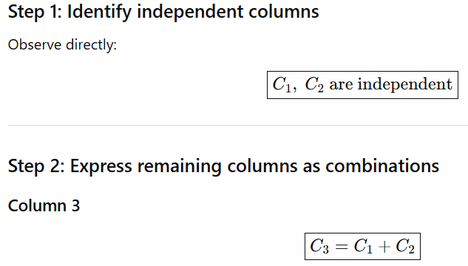
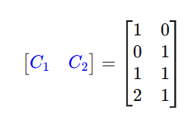
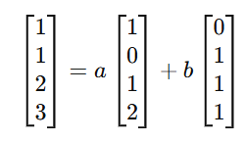
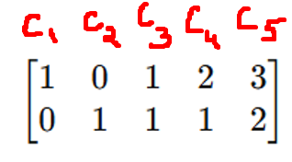
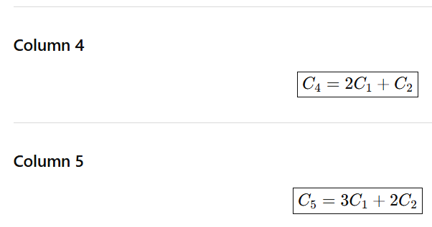
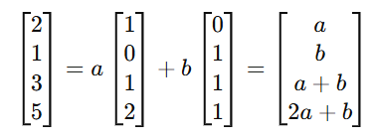

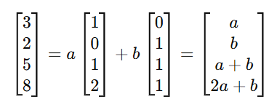
Rank
Rank = number of linearly independent rows or columns
Left matrix → column space
Right matrix → how each column is built
Here the Rank = 2 i.e. 2 independent columns from which actual matrix can be represented
C3,C4,C5 columns are dependent on C1,C2 where C1,C2 are independent columns

Slide 11
LoRA (Low-Rank Adaptation)
Number of Trainable Parameters
Percent of Total Parameters
Rank | 7B | 13B | 70B | 180B
1 | 167k | 228k | 529k | 849k
2 | 334k | 456k | 1M | 2M
8 | 1M | 2M | 4M | 7M
16 | 3M | 4M | 8M | 14M
512 | 86M | 117M | 270M | 434M
1,024 | 171M | 233M | 542M | 869M
8,192 | 1.4B | 1.8B | 4.3B | 7.0B
Rank | 7B | 13B | 70B | 180B
1 | 0.00% | 0.00% | 0.00% | 0.00%
2 | 0.01% | 0.00% | 0.00% | 0.00%
8 | 0.02% | 0.01% | 0.01% | 0.00%
16 | 0.04% | 0.03% | 0.01% | 0.01%
512 | 1.22% | 0.90% | 0.39% | 0.24%
1,024 | 2.45% | 1.80% | 0.77% | 0.48%
8,192 | 19.58% | 14.37% | 6.19% | 3.86%
As the Rank increases, the number of trainable parameters grows linearly. Start with small rank(r=8) and increase if underfitting.

Slide 12
FineTuning - LoRA
Step 4: Prepare Data (Example with HuggingFace dataset)
from datasets import load_dataset
dataset = load_dataset("samsum") # dialogue summarization example
def tokenize_fn(batch):
return tokenizer(batch["dialogue"], truncation=True, padding="max_length", max_length=512)
tokenized_dataset = dataset.map(tokenize_fn, batched=True)
Step 1: Load a Pretrained LLM
from transformers import AutoModelForCausalLM, AutoTokenizer
from peft import LoraConfig, get_peft_model
model_name = "meta-llama/Llama-2-7b-hf"
tokenizer = AutoTokenizer.from_pretrained(model_name)
model = AutoModelForCausalLM.from_pretrained(
model_name,
device_map="auto",
load_in_8bit=False # set True for memory constrained GPUs
)
Step 5: Training Loop
from transformers import Trainer, TrainingArguments
training_args = TrainingArguments(
per_device_train_batch_size=2,
gradient_accumulation_steps=4,
warmup_steps=50,
num_train_epochs=1,
learning_rate=3e-4,
fp16=True,
logging_steps=10,
output_dir="./lora_summarization",
save_strategy="steps",
save_steps=200
)
trainer = Trainer(
model=model,
args=training_args,
train_dataset=tokenized_dataset["train"],
eval_dataset=tokenized_dataset["validation"]
)
trainer.train()
Step 2: Define LoRA Config
lora_config = LoraConfig(
r=8, # LoRA rank
lora_alpha=16, # scaling factor
target_modules=["q_proj", "v_proj"], # which layers to adapt
lora_dropout=0.05,
bias="none",
task_type="CAUSAL_LM"
)
Step 3: Attach LoRA Adapters
model = get_peft_model(model, lora_config)
model.print_trainable_parameters() # check trainable params (~0.1%)

Slide 13
FineTuning - LoRA
Libraries You Need
pip install transformers # load LLMs
pip install peft # LoRA adapters + PEFT training
pip install accelerate # multi-GPU / mixed-precision
pip install datasets # optional for training data
pip install bitsandbytes # optional, for 4-bit or 8-bit fine-tuning (QLoRA)
Saving the LoRA Adapter Only
model.save_pretrained("./lora_summarization_adapter")
Only adapter weights are saved
Main model can be reloaded later
Target_modules in LoRA
Self-Attention
Query projection (q_proj)
Key projection (k_proj)
Value projection (v_proj)
Output projection (o_proj)
Feed-Forward Network (MLP)
Gate projection (gate_proj)
Up projection (up_proj)
Down projection (down_proj)
Use case | Recommended target_modules
Instruction tuning | ["q_proj", "v_proj"]
Chat / alignment | ["q_proj", "k_proj", "v_proj", "o_proj"]
Domain adaptation | + MLP projections
Low VRAM | Attention-only

Slide 14
Inference - LoRA Adapters
Loading Existing LoRA Adapter
from peft import PeftModel
# Load base model first
model = AutoModelForCausalLM.from_pretrained(
model_name,
device_map="auto"
)
# Load adapter
model = PeftModel.from_pretrained(model, "./lora_summarization_adapter")
Using Model for Inference
prompt = "Summarize the following conversation:\n" \
"Alice: Hi, how are you?\nBob: I'm good, thanks!\n"
inputs = tokenizer(prompt, return_tensors="pt").to(model.device)
outputs = model.generate(**inputs, max_new_tokens=50)
print(tokenizer.decode(outputs[0], skip_special_tokens=True))
Adapter is applied automatically during forward pass

Slide 15
Quantization
Quantization is the process of reducing numerical precision by mapping high-precision values (FP32/FP16) to lower-precision representations (INT8/INT4/FP8).
Why quantization is used
Reduce memory footprint
Increase inference speed
Reduce bandwidth & cache pressure
Enable deployment on CPUs / edge devices
Types of Quantization:
Based on target datatype
Integer quantization : FP → INT8 / INT4
Floating-point quantization : FP32 → FP16 / BF16 / FP8
Format | Sign | Exponent | Mantissa (Fraction) | Total Bits
FP32 (single precision) | 1 | 8 | 23 | 32
FP16 (IEEE half) | 1 | 5 | 10 | 16
BF16 (Brain Float 16) | 1 | 8 | 7 | 16

Slide 16
Integer Quantization
In interger quantization we have Symmetric vs Asymmetric Quantization.
Float values are real values: float to int range mapping
centered at zero (weights)
shifted away from zero (activations)
You cannot represent both efficiently with one scheme so will use
Symmetric quantization for weights
Asymmetric quantization for activations
We need to calculate Scale and Zero point to get the quantization done.

Slide 17
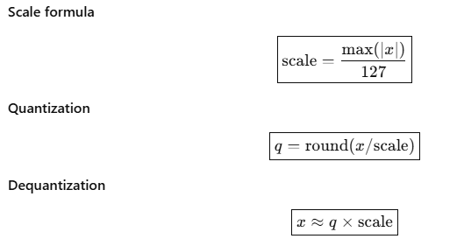
Symmetric Quantization
Integer range : INT8 → [-127 , +127]
Symmetric Quantization:
Integer range is centered at zero
Zero maps exactly to zero
No zero-point
Ex:
Float values: x values
[ -3.5 , -1.0 , 0.0 , 1.2 , 2.5 ]
max(|x|) = 3.5
scale = 3.5 / 127 ≈ 0.02756
q = round(x/scale)
X ≈ q × scale
Float | Calculation | INT8
-3.5 | -3.5 / 0.02756 = -127 | -127
-1.0 | -1.0 / 0.02756 = -36.3 | -36
0.0 | 0.0 / 0.02756 = 0 | 0
1.2 | 1.2 / 0.02756 = 43.5 | 44
2.5 | 2.5 / 0.02756 = 90.7 | 91
INT8 * Scale | Dequantized
-127 * 0.02756 | -3.50
-36 * 0.02756 | -0.99
0 * 0.02756 | 0.00
44 * 0.02756 | 1.21
91 * 0.02756 | 2.51
Zero maps to zero
No zero-point needed

Slide 18
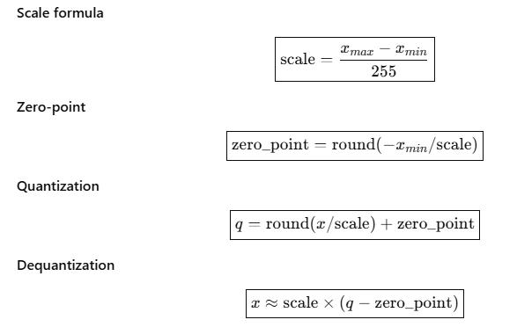
Asymmetric Quantization
Asymmetric Quantization : Some integer ranges are not symmetric.
Integer range is shifted
Zero may not map to integer zero
Requires zero-point
Ex:
Float values (activations):
[ 1.0 , 2.0 , 3.5 , 5.0 ]
x_min = 1.0
x_max = 5.0
scale = (5.0 - 1.0) / 255
scale ≈ 0.01569
zero_point = round(-1.0 / 0.01569)
zero_point ≈ -64 → clamp to 0 (clamp to valid integer range)
Integer range :UINT8 → [0 , 255]
Float | Calculation | UINT8
1.0 | round(1.0 / 0.01569) + 0 = 64 | 64
2.0 | 128 | 128
3.5 | 223 | 223
5.0 | 255 | 255
UINT8 | Dequantized
64 | 1.00
128 | 2.01
223 | 3.50
255 | 5.00

Slide 19
QLORA
QLoRA : Quantized LoRA
Combines LoRA adapters with 4-bit quantization of the base model
Allows fine-tuning very large language models (up to 65B+) on a single GPU or limited hardware
Key idea: freeze the quantized base weights and learn low-rank adapters on top
Why QLoRA Exists
Problem with traditional LoRA
LoRA reduces training parameters
But base model (e.g., 13B+) still consumes hundreds of GB in memory
Reduces memory requirements ~4–5×
No major loss in performance
QLoRA may be slightly slower than LoRA fp16 per forward/backward pass
due to on-the-fly dequantization of the base weights to float16 for matrix multiplication, but memory usage is drastically reduced because the base model is stored in 4-bit and only LoRA adapters store gradients.
Base weights are stored in 4-bit → tiny memory
But GPUs cannot multiply float16 activations by 4-bit weights directly
So W is dequantized to float16 temporarily → multiply by activations (X @ W_float16)
LoRA updates (B @ A) are added → result = next layer activations

Slide 20
FineTuning - QLORA
#pip install transformers peft accelerate bitsandbytes datasets
from transformers import AutoModelForCausalLM, AutoTokenizer
from peft import LoraConfig, get_peft_model
model_name = "meta-llama/Llama-2-13b-hf"
tokenizer = AutoTokenizer.from_pretrained(model_name)
model = AutoModelForCausalLM.from_pretrained(
model_name,
device_map="auto",
load_in_4bit=True, # QLoRA setup
quantization_config={"bnb_4bit_compute_dtype": "float16"}
)
# LoRA adapter
lora_config = LoraConfig(
r=16,
lora_alpha=32,
target_modules=["q_proj", "v_proj"],
lora_dropout=0.05,
task_type="CAUSAL_LM"
)
model = get_peft_model(model, lora_config)

Slide 21
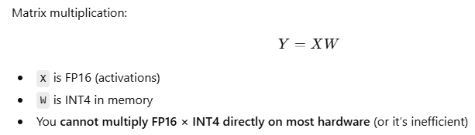
Inference - QLORA
from transformers import AutoModelForCausalLM, AutoTokenizer
from peft import PeftModel
base_model = AutoModelForCausalLM.from_pretrained("meta-llama/Llama-2-13b-hf", load_in_4bit=True)
model = PeftModel.from_pretrained(base_model, "./lora_adapter")
tokenizer = AutoTokenizer.from_pretrained("meta-llama/Llama-2-13b-hf")
prompt = "Explain QLoRA in simple words:"
inputs = tokenizer(prompt, return_tensors="pt").to(model.device)
outputs = model.generate(**inputs, max_new_tokens=50)
print(tokenizer.decode(outputs[0], skip_special_tokens=True))
Dequantization during inference
Base model is still stored in 4-bit
During forward pass, bitsandbytes dequantizes W → float16 temporarily for matrix multiplication
LoRA adapters (ΔW) are added as usual
Important:
Temporary float16 dequantization is still required, but since no backward pass, memory usage is much smaller
Activations are also only stored for the current forward pass → smaller footprint

Slide 22
Quantization - Variants
Format | Quantization naming
.gguf | Q4_0, Q4_K_M, Q8_K
.pt | fp16, int8, nf4
.safetensors | fp16, bf16, int8
.onnx | int8, fp16, QDQ
GGUF Quantization Formats: _0, _1, _K, _K_S, _K_M
used by llama.cpp, ollama etc.
Part | Meaning
Q4 | 4-bit weight quantization (INT4)
_K | K-quantization (block-wise, grouped scaling used by llama.cpp)
_M | Medium precision for block scale metadata
Q4_0, Q4_K, Q4_K_S, Q8_K_M etc.
Quantization formats (or variants)
_0, _1 → Legacy quantization formats
_K → Modern K-quant quantization
_K_S, _K_M, _K_L → Modern K-quant variants balancing size vs quality
Notes:
https://ollama.com/library/qwen3-vl:latest

Slide 23
Quantization : _K_M
_K means : Instead of one scale for the entire tensor, we split the tensors into fixed-size blocks and compute one scale
Weights are split into blocks (usually 256 values)
Each block has:
Quantized INT8 values
A block scale
Ex: FP16 to int8
Weights(FP16): [ 0.1, 0.2, 0.15, 0.18, 3.2, 3.5, 3.1, 3.4 ]
Block size = 2
Block1 : [0.1, 0.2, 0.15, 0.18] → scale₁ = max(|x|)/127 = 0.2 / 127 ≈ 0.0015748
Qunatized values : int8 → [64,127,95,114]
Block2 : [3.2, 3.5, 3.1, 3.4] → scale₂ = max(|x|)/127 = 3.5 / 127 ≈ 0.027559
Qunatized values : int8 → [116,127,113,123]
Stored values:
[int8 values] + [scale₁] + [scale₂]
_M means : _M controls how the block scale itself is stored
In K-quantization:
You don’t just quantize weights — you also store scale values
_M = Medium precision scale representation
Variant | Scale storage | Accuracy | Size
_S | Very low precision | Lowest | Smallest
_M | Medium precision | Balanced | Medium
_L | High precision | Best | Larger
Notes:
https://ollama.com/library/qwen3-vl:latest

Slide 24
PTQ Vs QAT
Post-Training Quantization (PTQ)
PTQ is a method where you take a fully trained model (usually in FP32 or FP16) and convert its weights and/or activations to lower precision (like INT8, INT4) after training is complete.
There is no retraining involved, though sometimes a small calibration dataset is used.
GPTQ and AWQ are PTQ methods designed to reduce accuracy loss when quantizing weights.
GPTQ - Generative Pre-trained Transformer Quantization
AWQ - Activation-aware Weight Quantization
Quantization-Aware Training (QAT)
QAT simulates quantization during training itself.
The model “learns” to work well with lower-precision numbers.
Both weights and activations are effectively trained to be robust under quantization.
Notes:
https://ollama.com/library/qwen3-vl:latest

Slide 25
PTQ Vs QAT
Feature | Post-Training Quantization (PTQ) | Quantization-Aware Training (QAT)
When applied | After training | During training/fine-tuning
Requires retraining? | No | Yes
Accuracy drop | Can be significant for sensitive models | Minimal
Complexity | Simple | Complex
Best for | Quick deployment, low compute | High-accuracy deployment
Bit-level aggressiveness | INT8 usually | INT8, INT4, very low bits
Notes:
https://ollama.com/library/qwen3-vl:latest

Slide 26
Thank you

